Slide 1
Errors & Exceptions of Python

Slide 2

Syntax Errors
Syntax errors, also known as parsing errors, are perhaps the most common kind of error you encounter while you are still learning Python.
The parser repeats the offending line and displays a little ‘arrow’ pointing at the earliest point in the line where the error was detected. The error is detected at the token preceding the arrow. File name and line number are printed so you know where to look in case the input came from a script.

Slide 3
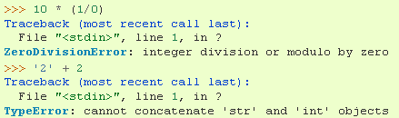
Exceptions
Even if a statement or expression is syntactically correct, it may cause an error when an attempt is made to execute it. Errors detected during execution are called exceptions and are not unconditionally fatal. Most exceptions are not handled by programs, however, and result in error messages like “cannot divide by zero” or “cannot concatenate ‘str’ and ‘int’ objects”.

Slide 4
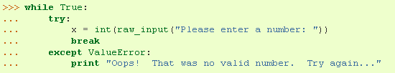
Handling Exceptions
It is possible to write programs that handle selected exceptions. Consider the following, where a user-generated interruption is signaled by raising the KeyboardInterrupt exception.
First the 'try' clause is executed until an exception occurs, in which case the rest of 'try' clause is skipped and the 'except' clause is executed (depending on type of exception), and execution continues. If an exception occurs which does not match the exception named in the except clause, it is passed on to outer try statements; if no handler is found, it is an unhandled exception and execution stops.

Slide 5
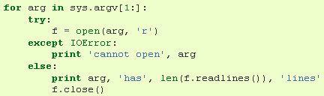
The last except clause (when many are declared) may omit the exception name(s), to serve as a wildcard. This makes it very easy to mask a real programming error. It can also be used to print an error message and then re-raise the exception.
The try-except statement has an optional else clause, which, when present, must follow all except clauses. It is useful for code that must be executed if the try clause does not raise an exception.

Slide 6

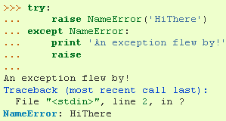
Raising Exceptions
The raise statement allows the programmer to force a specified exception to occur.
The sole argument to raise indicates the exception to be raised.
A simpler form of the raise statement allows one to re-raise the exception (if you don’t want to handle it):

Slide 7
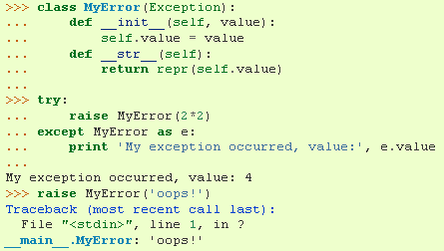
User-defined Exceptions
Programs may name their own exceptions by creating a new exception class. These are derived from the Exception class, either directly or indirectly.
Here, the def__init__() of Exception has been overridden. The new behavior simply creates the value attribute.

Slide 8
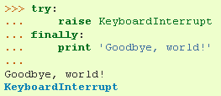
Defining Clean-up Actions
The try statement has another optional clause which is intended to define clean-up actions that must be executed under all circumstances.
A finally clause is executed before leaving the try statement, whether an exception has occurred or not. When an exception has occurred in the try clause and has not been handled by an except clause, it is re-raised after the finally clause has been executed. The finally clause is also executed “on the way out” when any other clause of the try statement is exited using break/continue/return.

Slide 9


Predefined Clean-up Actions
Some objects define standard clean-up actions to be undertaken when the object is no longer needed, regardless of whether or not the operation using the object succeeded or failed.
The problem with this code is that it leaves the file open for an indefinite amount of time after the code has finished executing.
The ‘with’ statement allows objects like files to be used in a way that ensures they are always cleaned up promptly and correctly.

Slide 10
Questions or concerns?

Slide 11
Resource Used
Python v2.7 Documentation Section 8 Link: http://docs.python.org/tutorial/errors.html

